Slide 1
Code Visualization using Virtual Reality
BTP from Sem V by:
Anurag Shah, B16CS034
Chinmay Garg, B16CS041
Under guidance of Dr. Sumit Kalra
(CSE Department, IIT Jodhpur)

Slide 2
Overview
Under our B.Tech. Technical Project for the Semester V, we have developed a Virtual Reality software application which visualizes the process of debugging.
This project was performed under the guidance of Dr. Sumit Kalra.
The project was developed on Unity3d software(in Windows OS) and on Linux OS. Debugging was done through the help of GNU GDB software.

Slide 3
Understanding the problems
01
Logical and runtime errors are a headache! They occur frequently wasting too much time of a programmer. Even when using gdb, it is time consuming and involves a lot of effort.
02
Many people do not know how to use gdb. So it becomes an overhead if one wants to code.
03
Even if somebody uses gdb he/she should be putting breakpoint at correct position.

Slide 4
Project objective
This project intends to implement the debugging process in a three-dimensional computer-generated virtual environment using VR technologies, in such a way so as to increase the ease of performing this process, all the while making it more visually powerful.

Slide 5
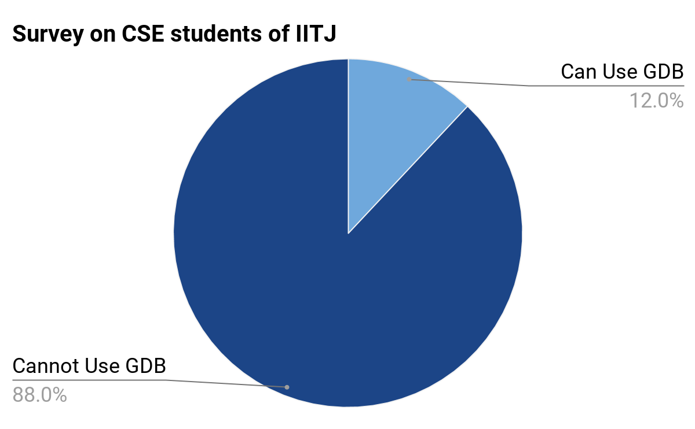
Dire Need for an Easy Debugger
On a survey done on the CSE students of our institute, only 3 out of 25 students were able to debug using the GNU GDB software.
Most of them were unfamiliar with the standard procedure of debugging and were using cout statements inside the code for the debugging purposes.

Slide 6



Target audience
All those programmers who are fed up of runtime and logical errors.
All those programmers who don’t know how to debug.

Slide 7
Product Advantages
01
A virtual space eliminates requirements of multiple screens, as it provides a 360-degree view, in which we can place multiple virtual screens or a single 360-degree curved screen.
02
Can also be used by programmers who lack the knowledge and experience in debugging using the GDB software.
03
The speed of the process can be adjusted by the users, according to their needs. Also, the whole process of debugging requires no intervention from the user, making this a hands-free experience.

Slide 8
Developing the Product
The development was done simultaneously on two sides:
I. Linux Side
II. Unity Side in Windows OS

Slide 9
The Linux Side of Development
We wrote a script, named 'script.sh', to compile and debug the C++ program, named 'main.cpp'.
This script also implements the time command and retrieves other relevant information regarding the process, storing them in a file named 'time.txt'.
The script also executes a C++ program named 'func_finder.cpp'. This program finds all the functions and stores them in a file named 'func_list.txt'.
We have written a GDB script inside ‘inputgdb.txt’, which makes successive calls for the 'step' and 'info locals' functions.
For the GDB process, pagination is set to off, so that irrelevant information is not displayed, and logging is set to on, so that the output is stored in a file named 'gdb.txt'. The breakpoint is set at main().

Slide 10
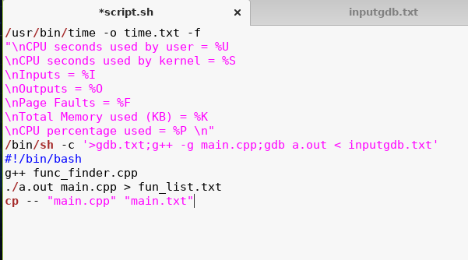
The Script

Slide 11
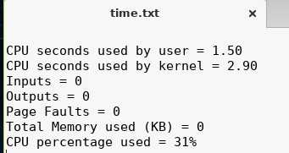
Time Command Utility

Slide 12
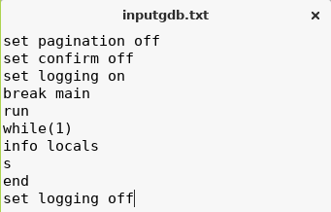
GDB Scripting

Slide 13
The Unity Side of Development
Here we made two Game Scenes:
Menu
Main
In ‘Menu’ Game Scene, we have made our homescreen and the aboutscreen of our app.
In ‘Main’ Game Scene, we have the debugging process going on.

Slide 14
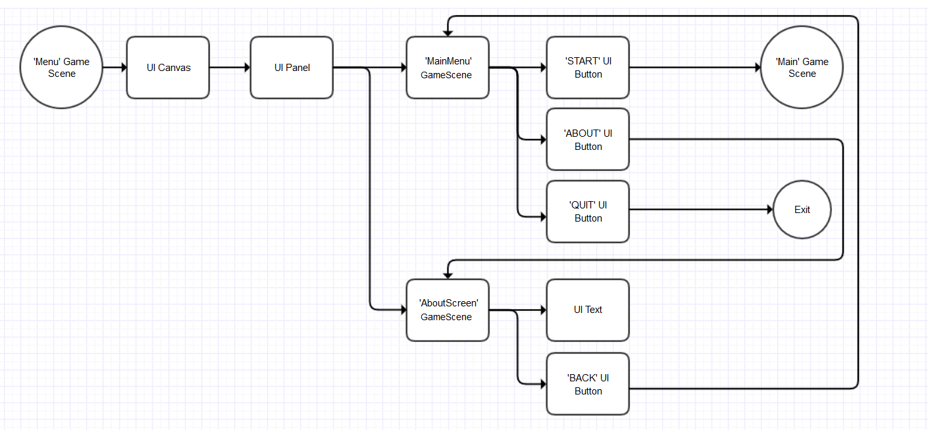
‘Menu’ Game Scene

Slide 15
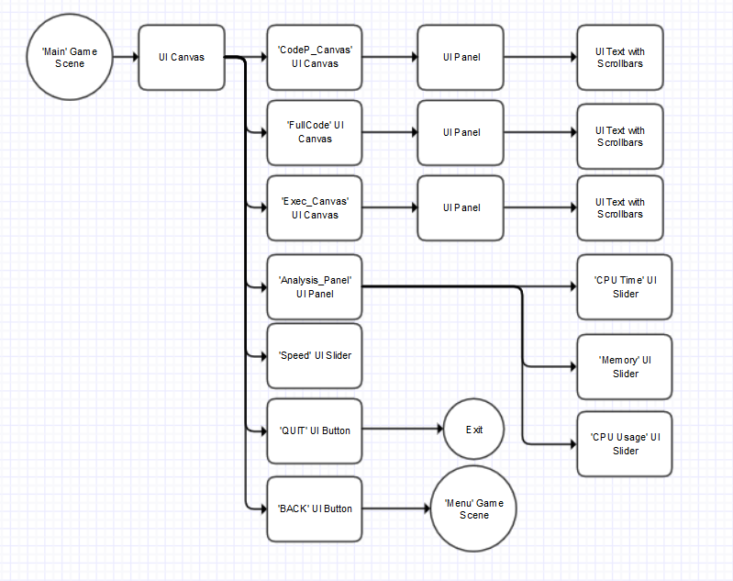
‘Main’ Game Scene

Slide 16
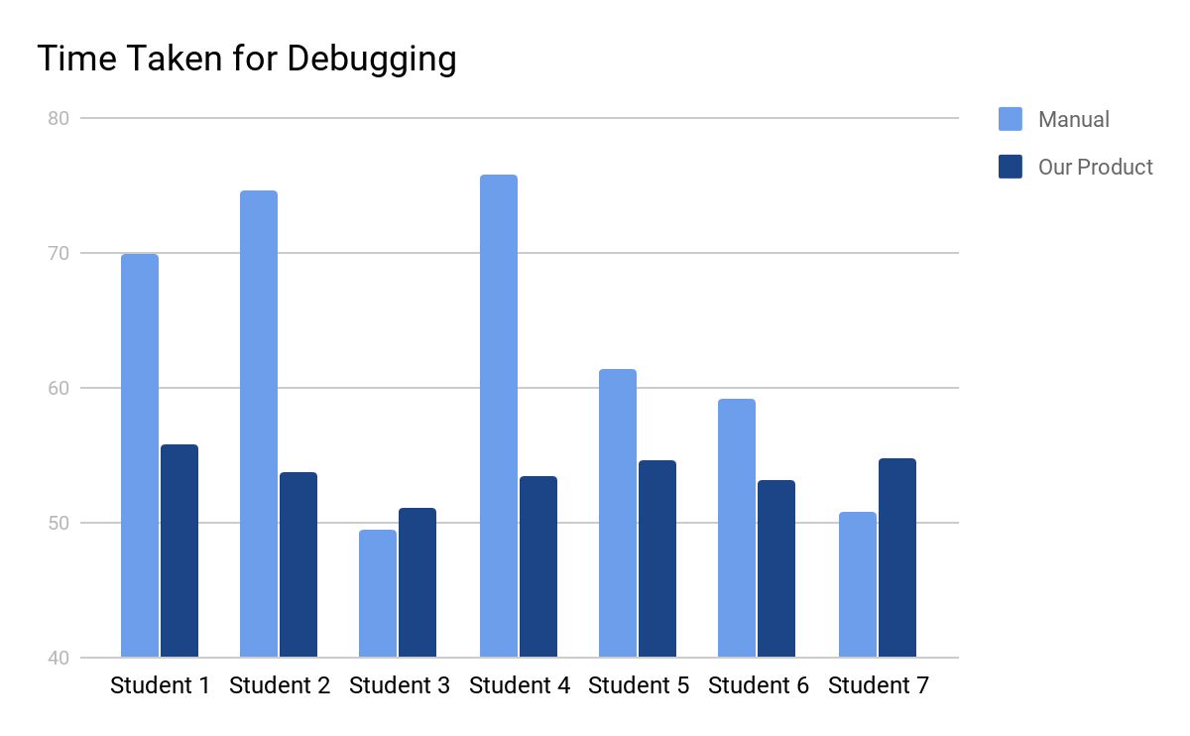
Product Efficiency Survey
We conducted a survey on our friends by giving them a C++ code with a runtime error and then asked them to debug it. First, manually and then using our product.
The result was as clear as a day. Our Product not only decreased the time required to debug that error, but also gave a sure shot result every time in one go, which was not the case with the manual debugging.
The small differences in the 2 corresponding readings is due to the small size of the code.

Slide 17
Challenges Faced
01
This was the pioneer project done on the Virtual Reality technology, done in our institute. None of our seniors or batchmates had done anything in this field. Even most of us were seeing a Virtual Reality headset for the first time in our life.
02
Almost no tutorials or documentations available guiding the development of a VR based ‘utility’ app. For every single thing, we had to relate the process with the game development, which is an extremely different field, or had to go with our intuitions.
03
The cloud services provided by Unity Technologies is very poor. Even after trying for multiple times, we were unable to collaborate on a project through Unity. Finally, we had to do the project on one PC, taking turns, reducing our efficiency.

Slide 18
Behind the scenes
We have C# code attached to the GameObjects which manage all the events in our app.

Slide 19
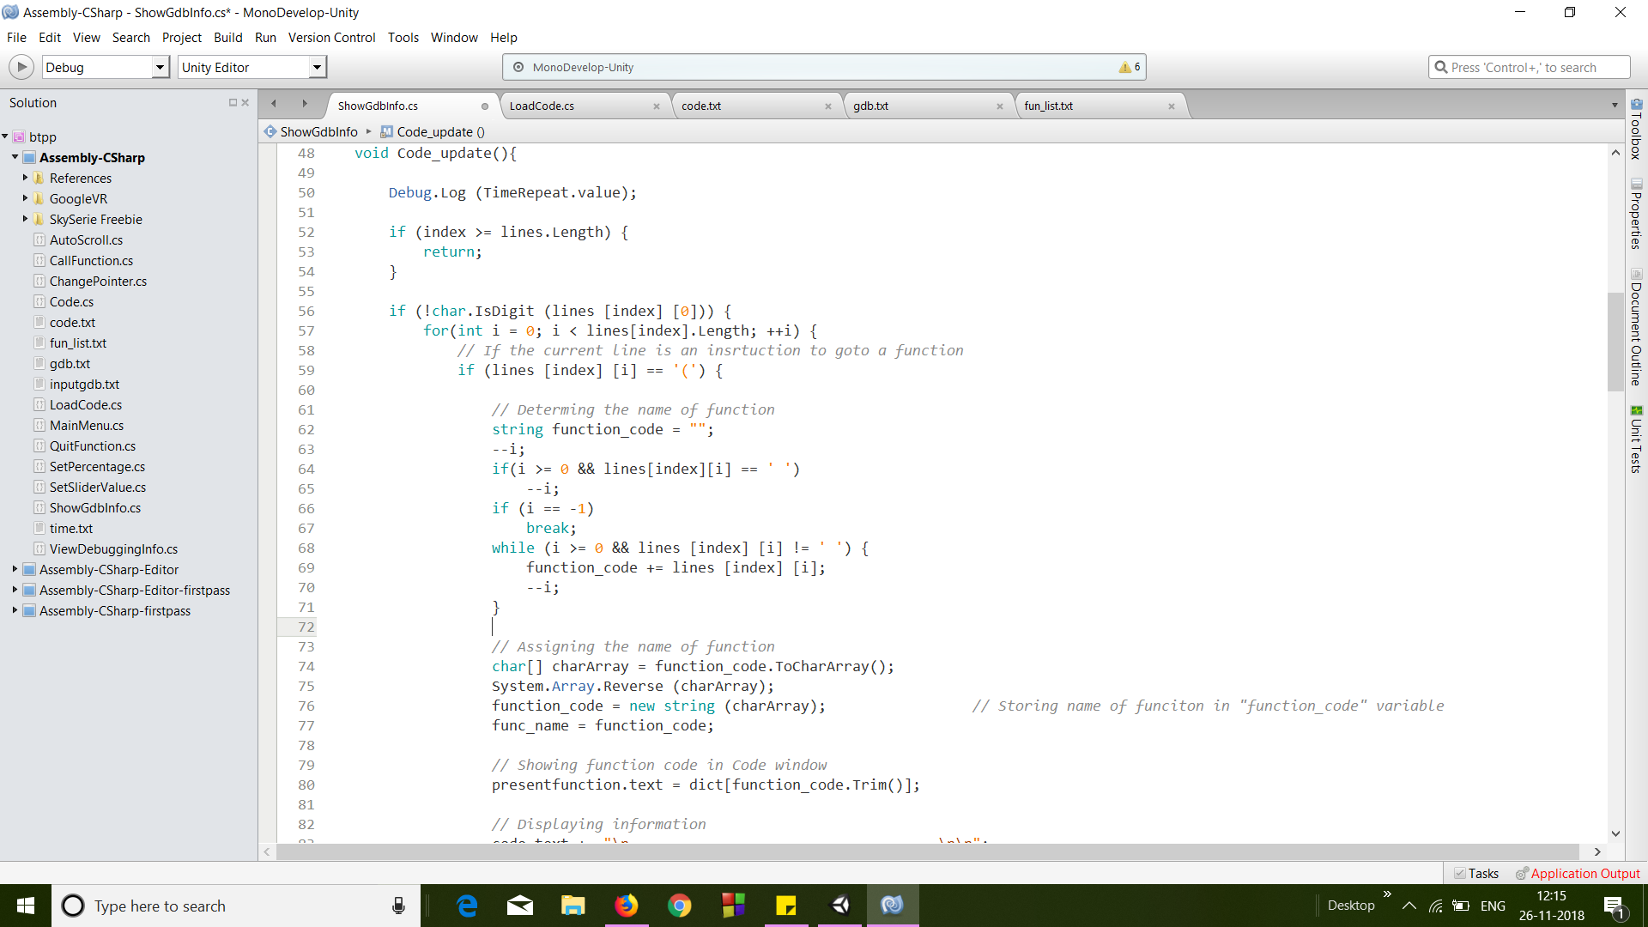
This “code_update()” function is used to update the debugging information in the execution window

Slide 20
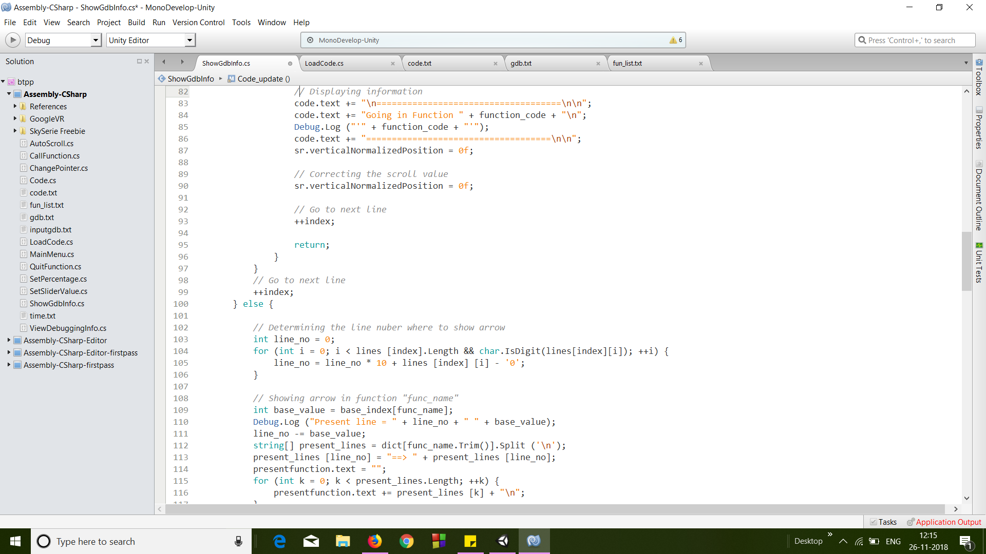

Slide 21
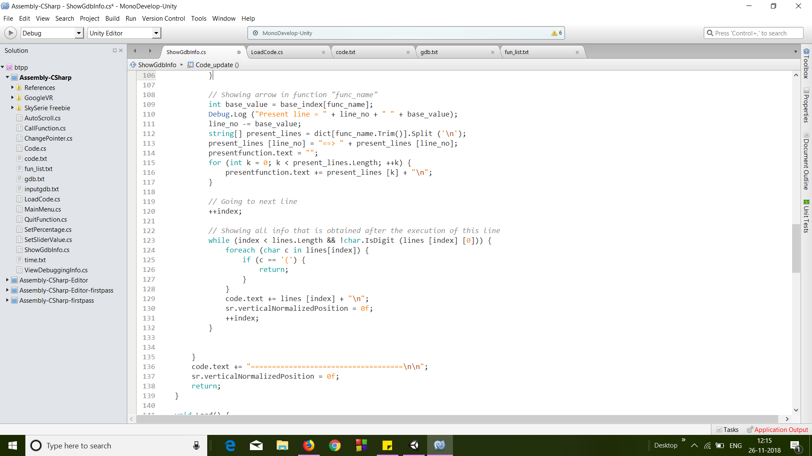

Slide 22
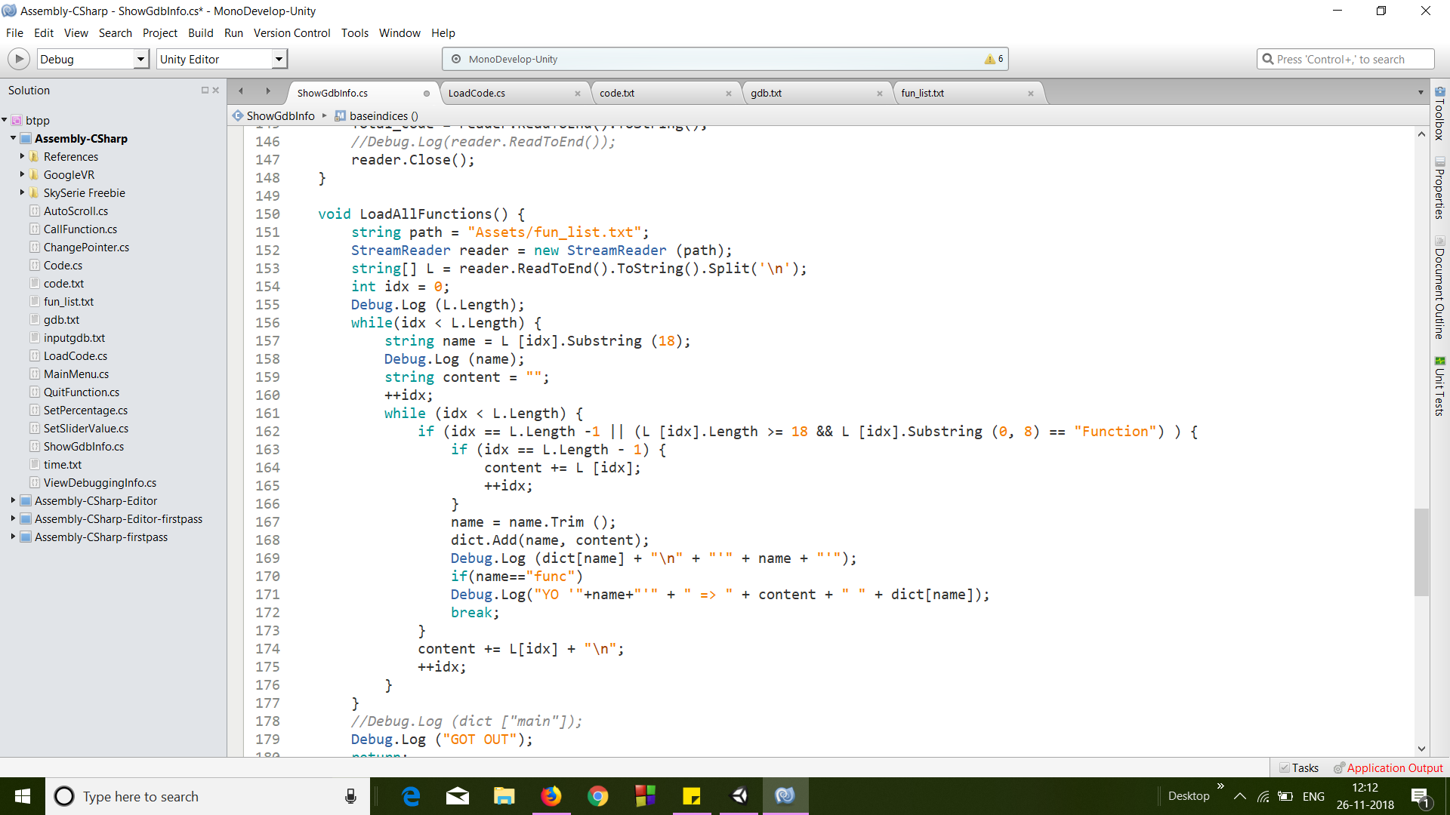
The “LoadAllFunctions()” function is used to Load all the functions in a Dictionary named dict.

Slide 23
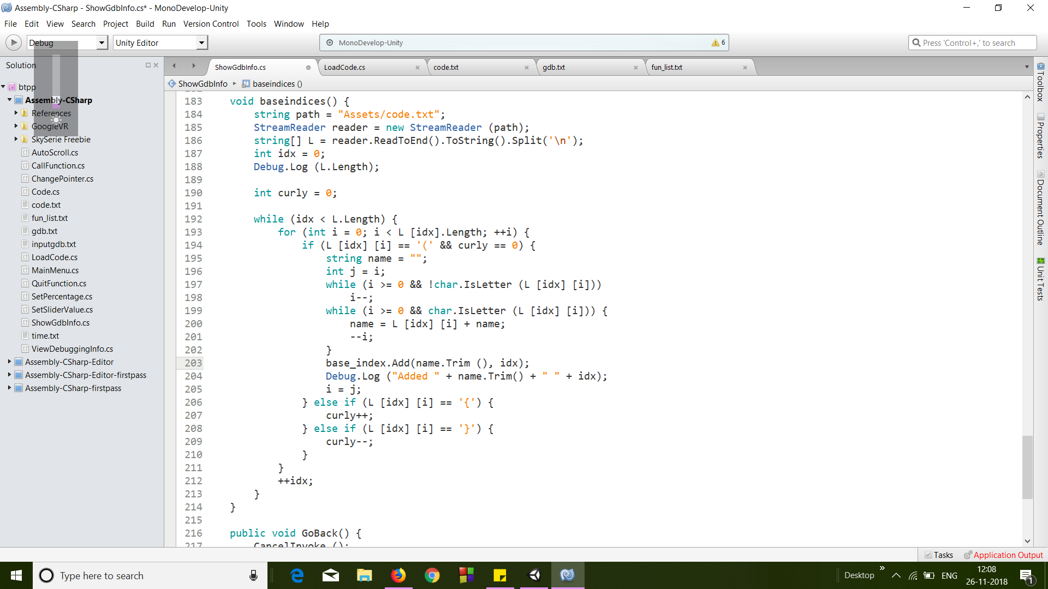
The “baseindices() function is used to Load all the function names in a Dictionary called base_index.

Slide 24
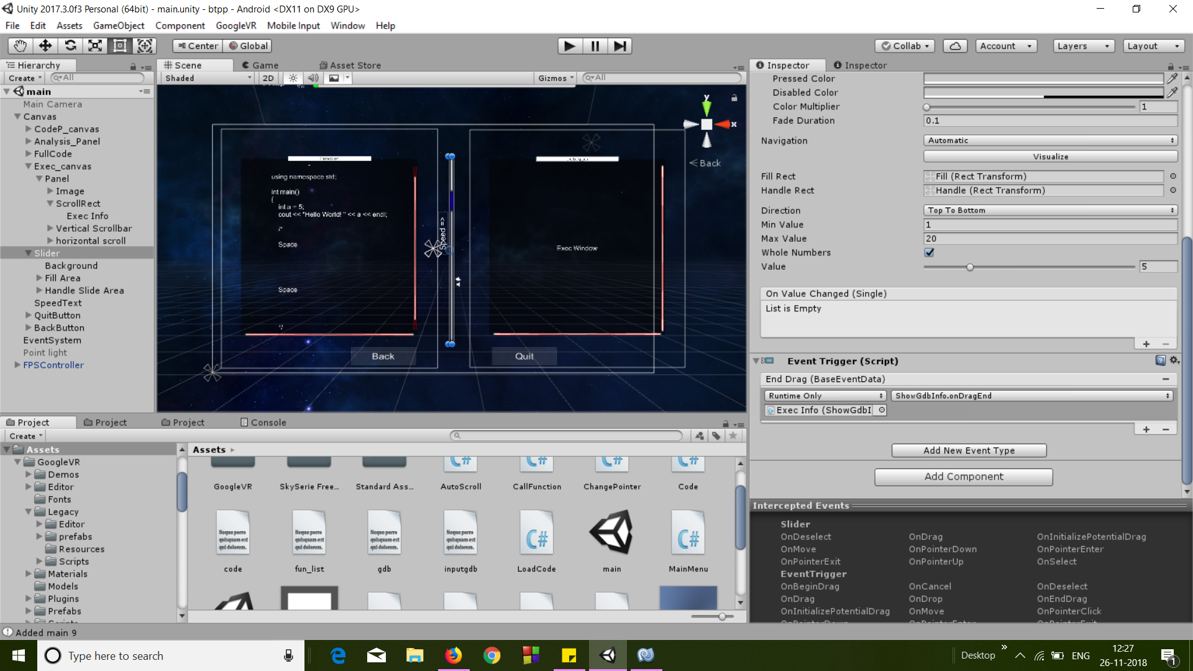
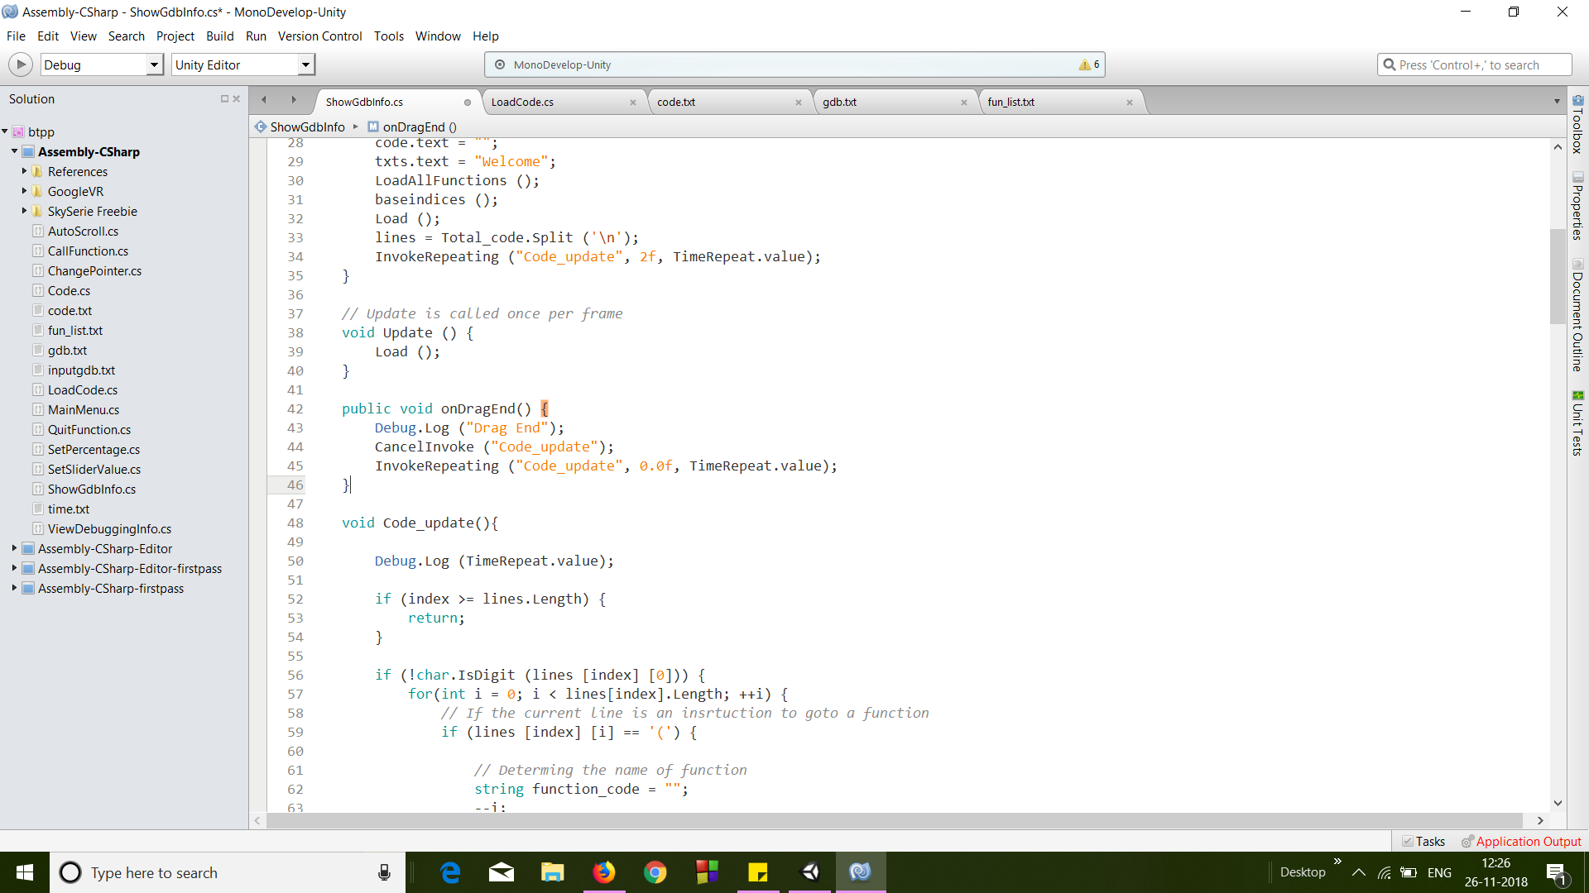
“OnDragEnd()” function helps to update the speed of execution.

Slide 25
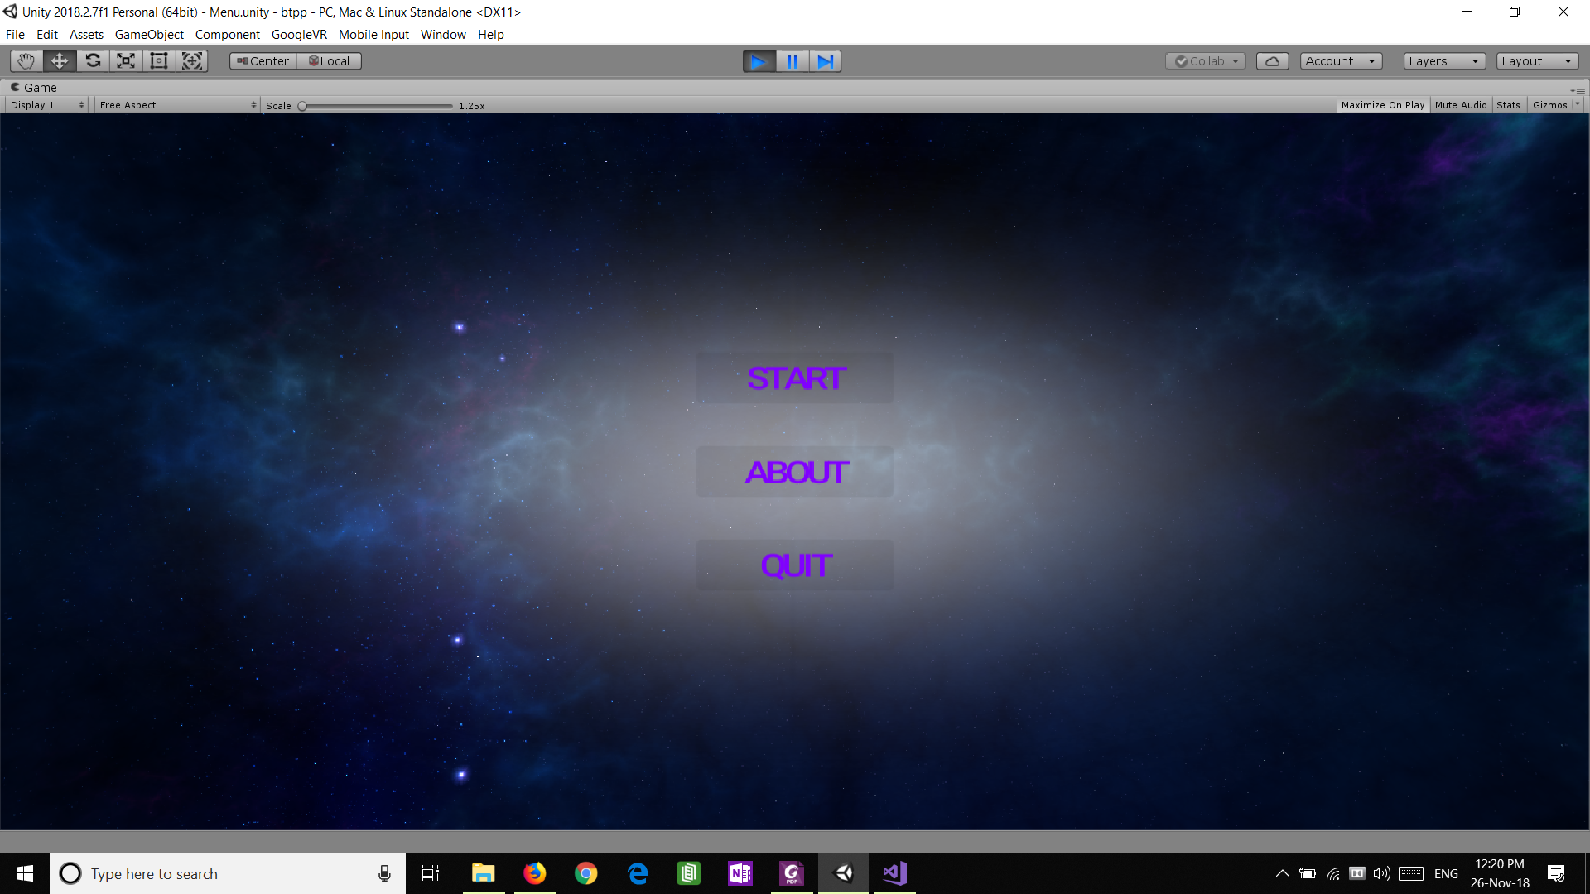
Now, let's watch the demo run for this product.
Product Demo
We will be running a .exe file build for this project in Windows OS environment.

Slide 26
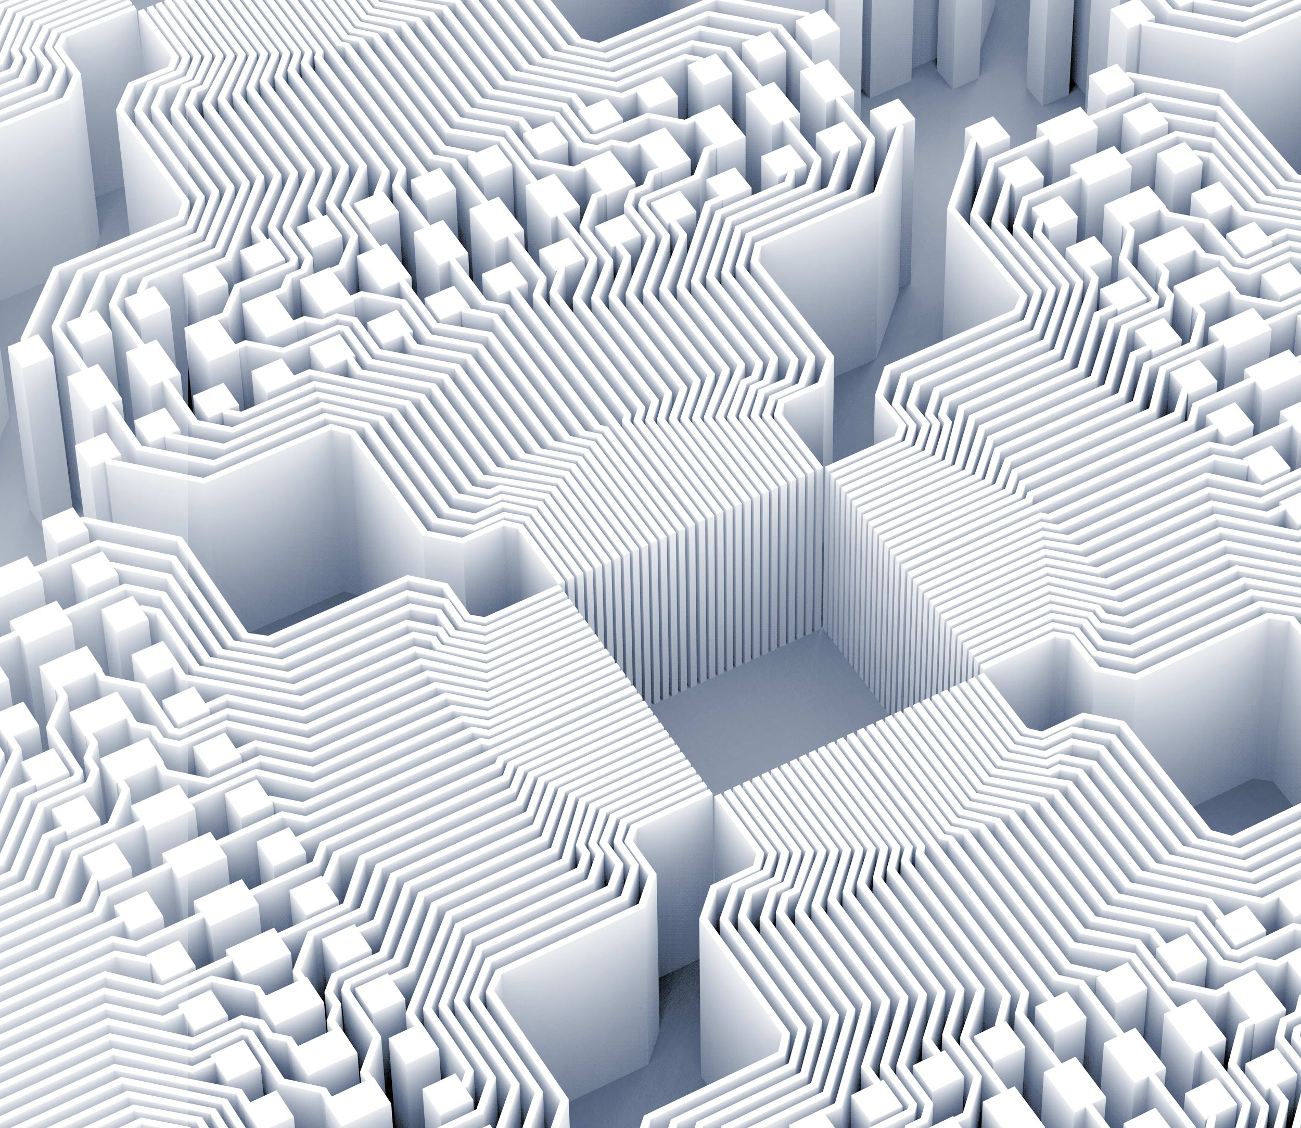
Thank you!

